Slide 1
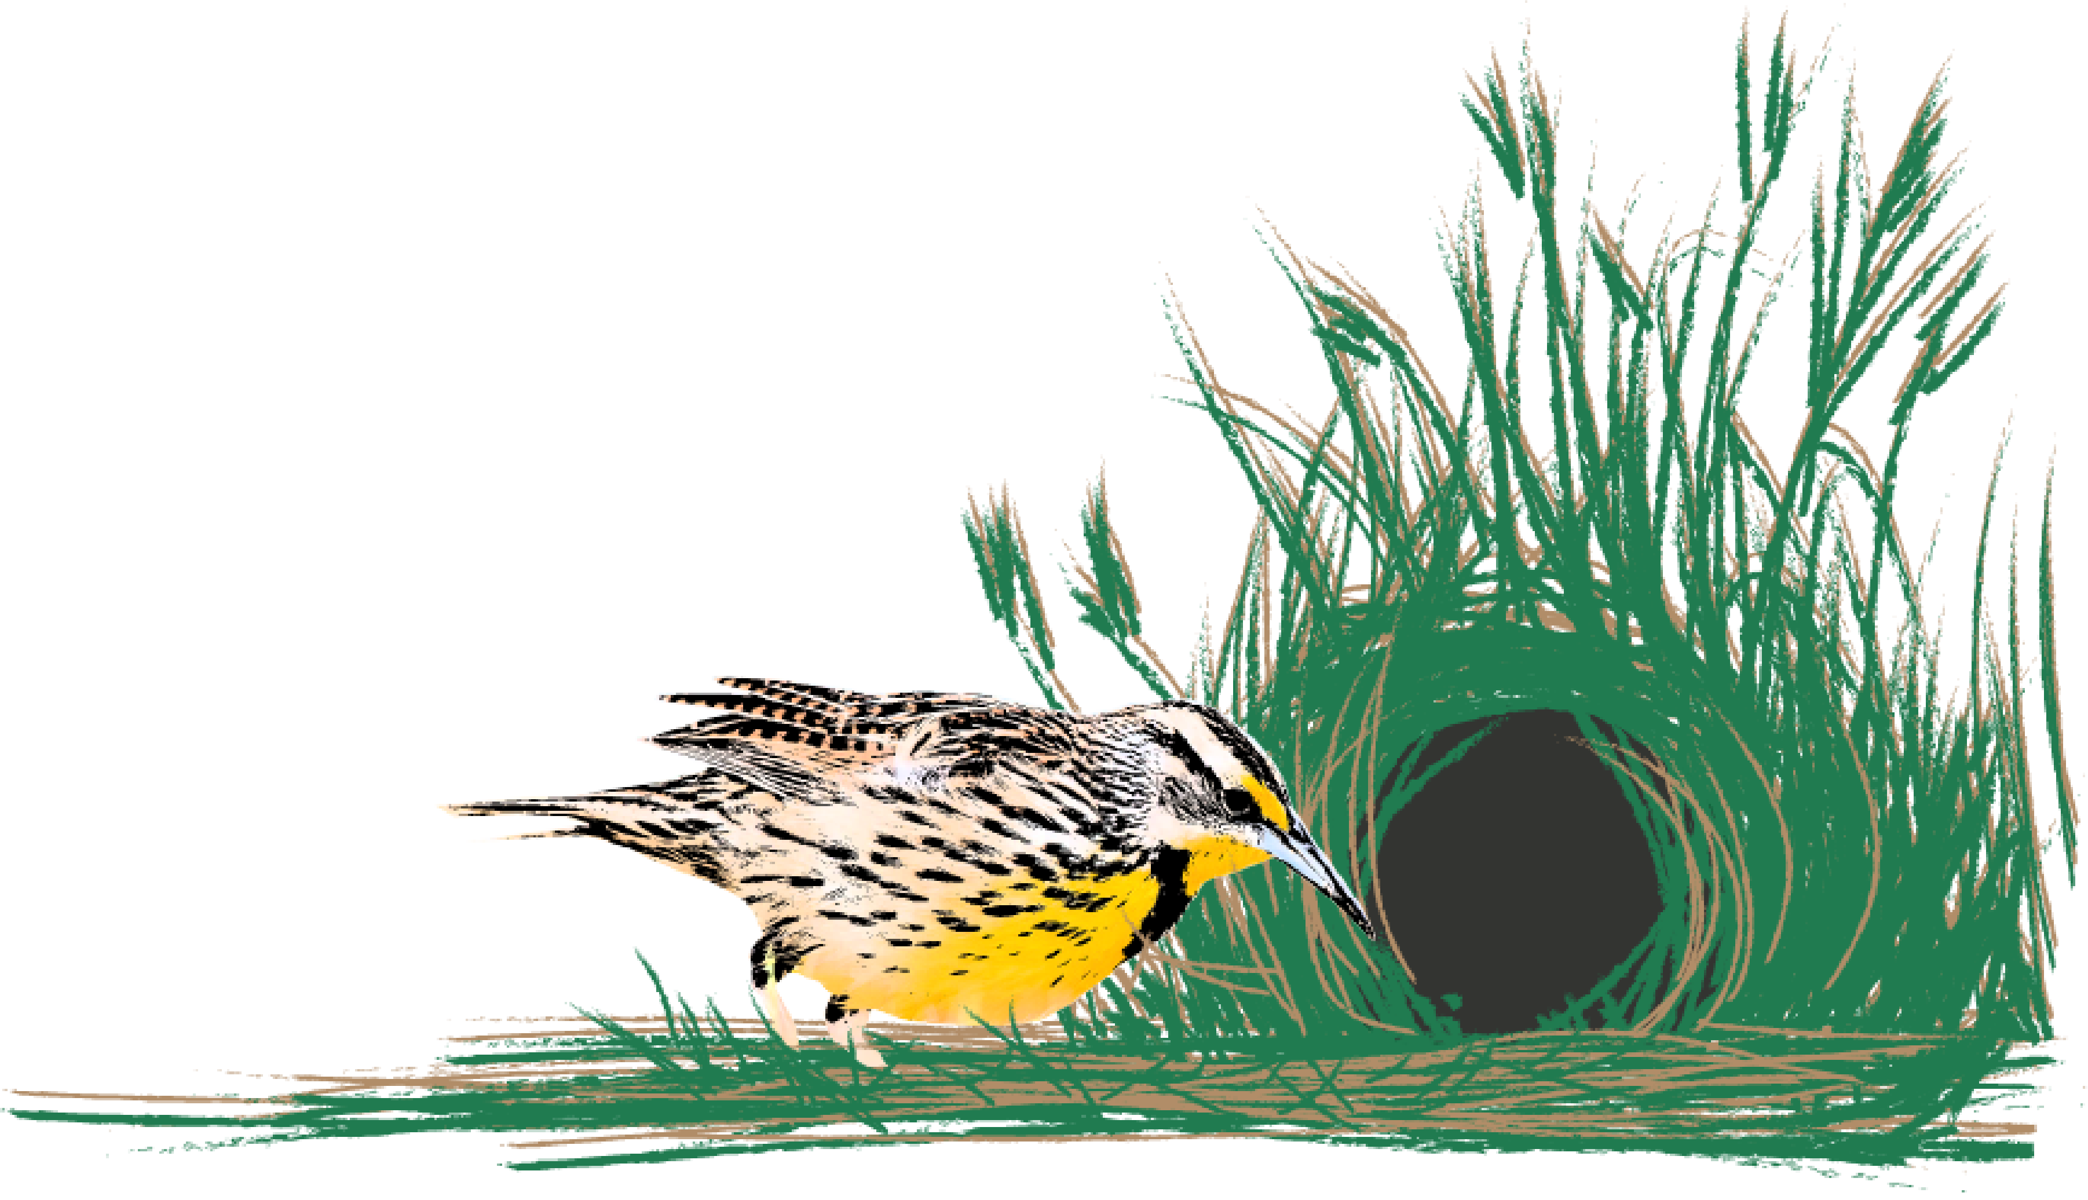


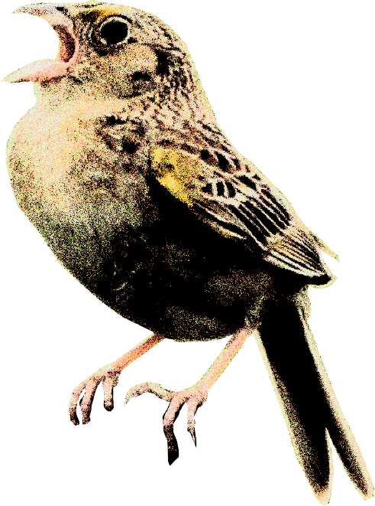
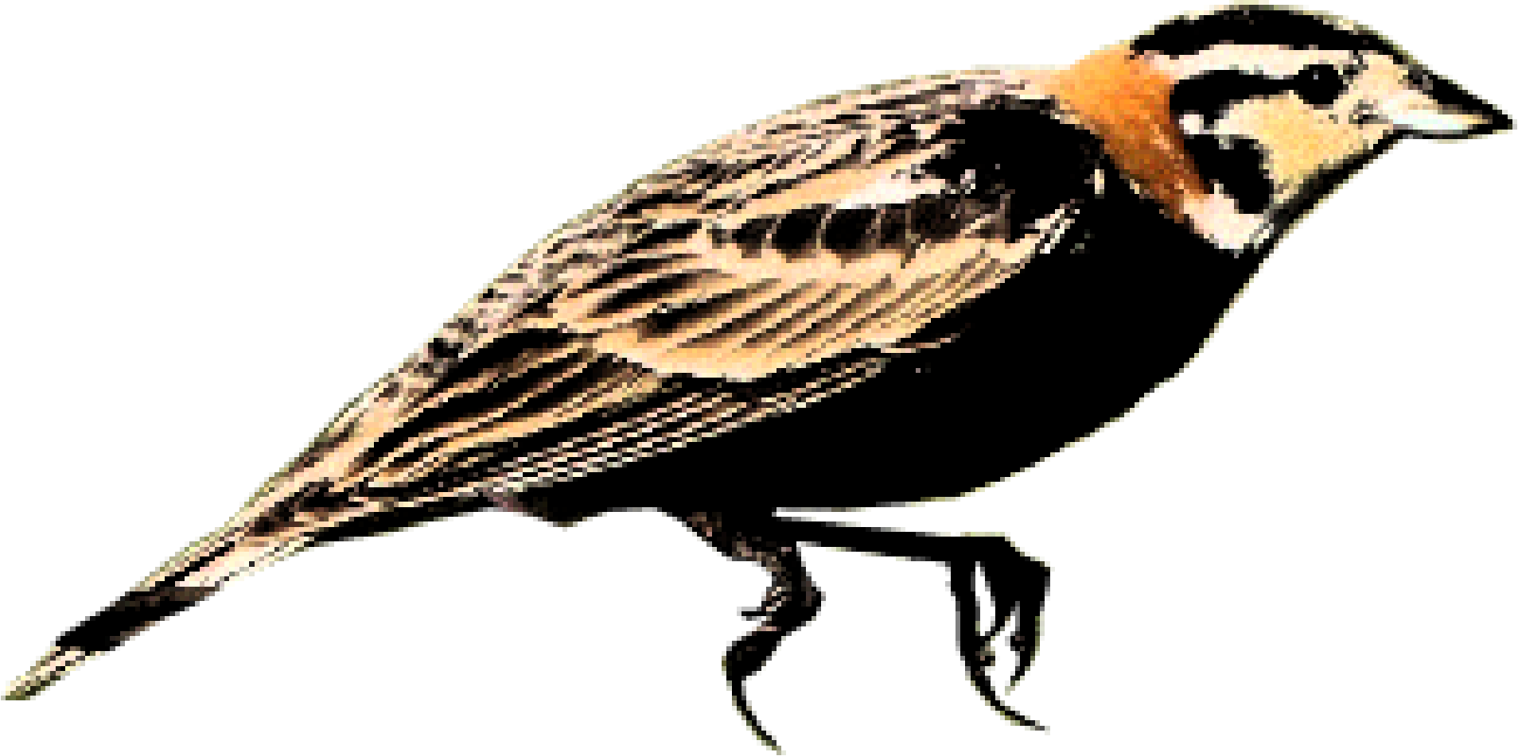
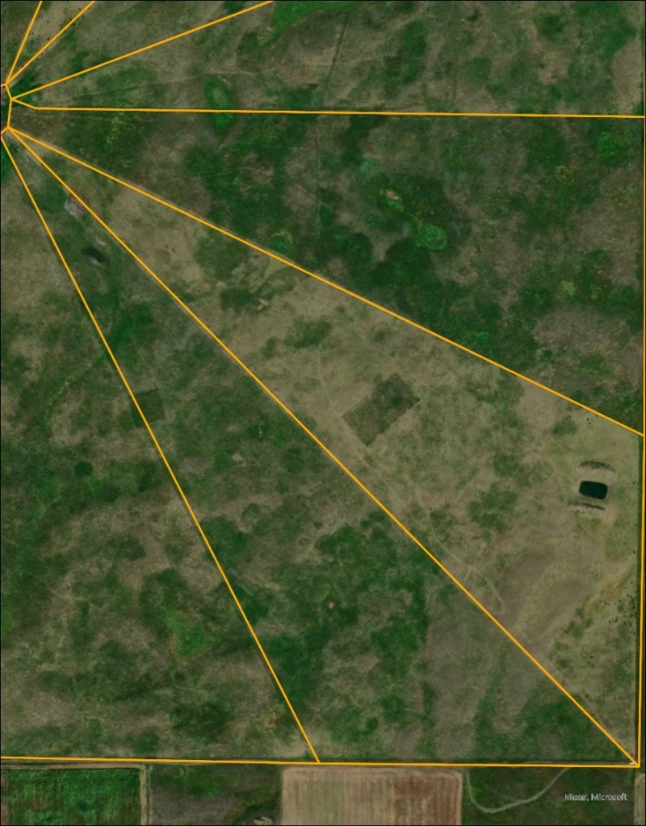
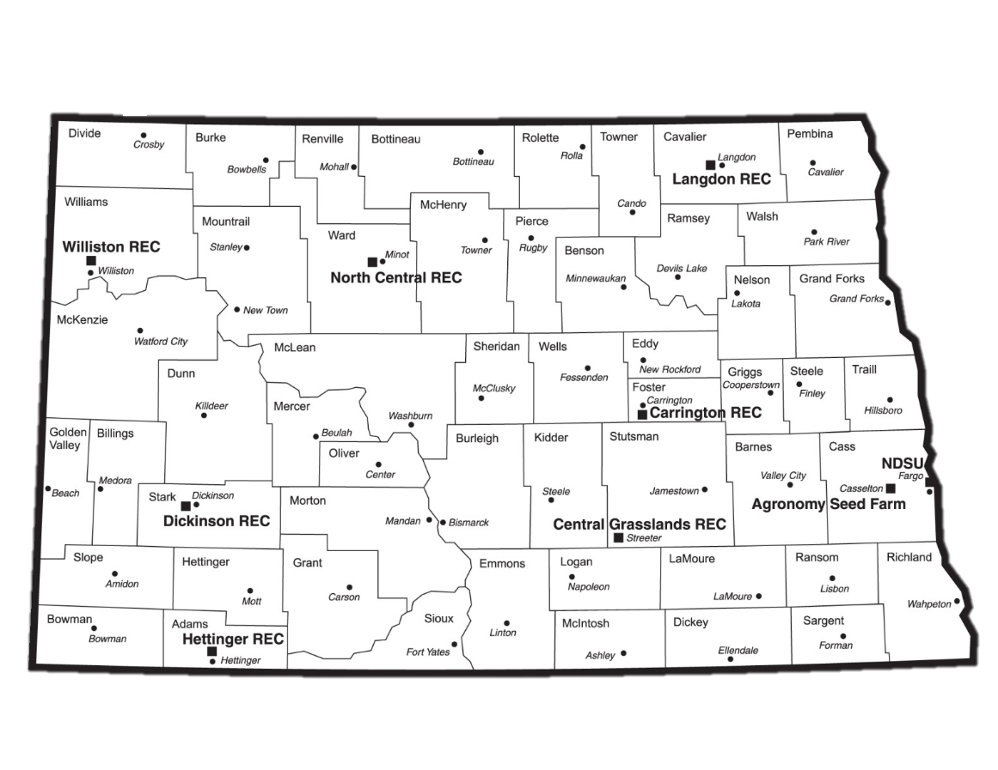

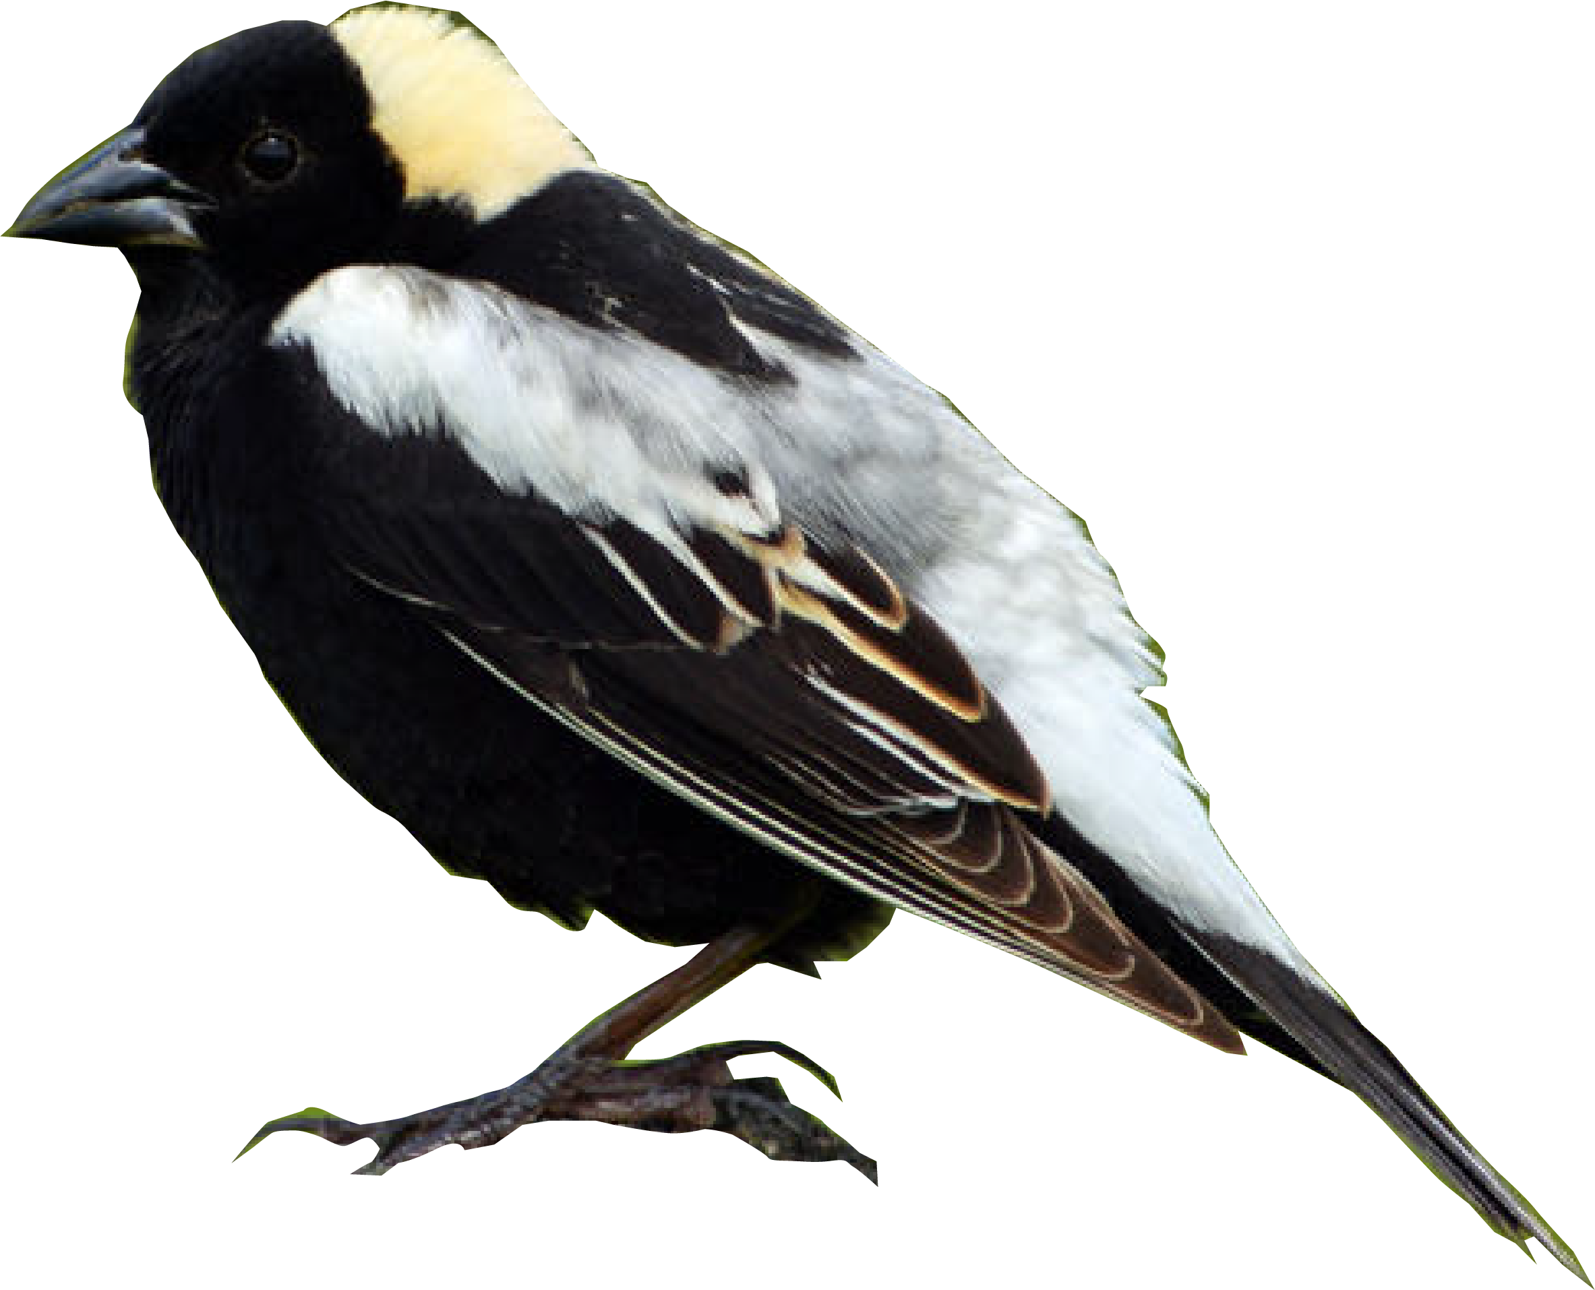
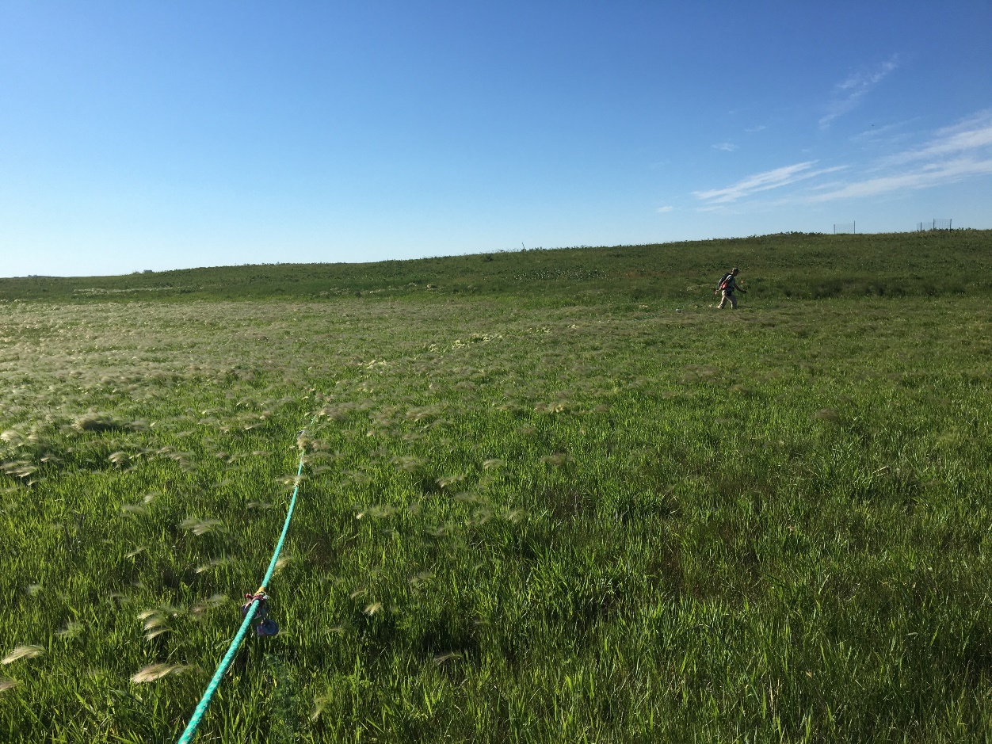
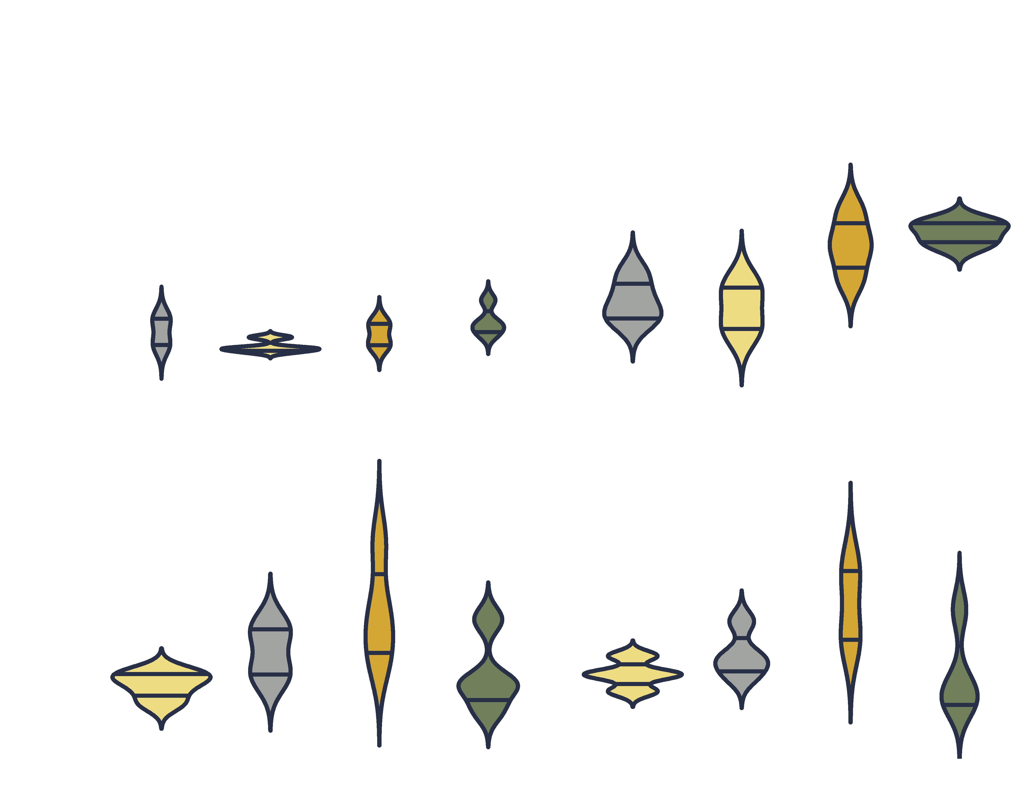
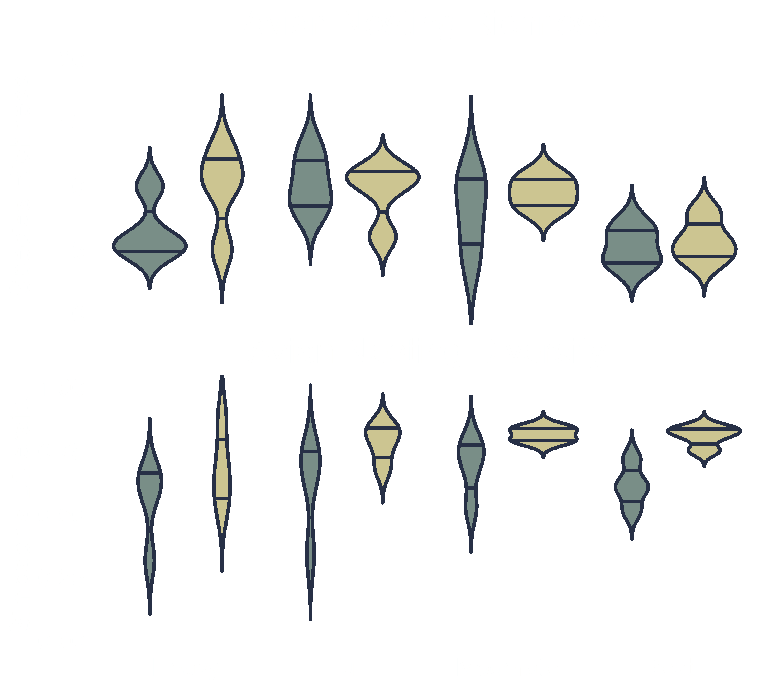
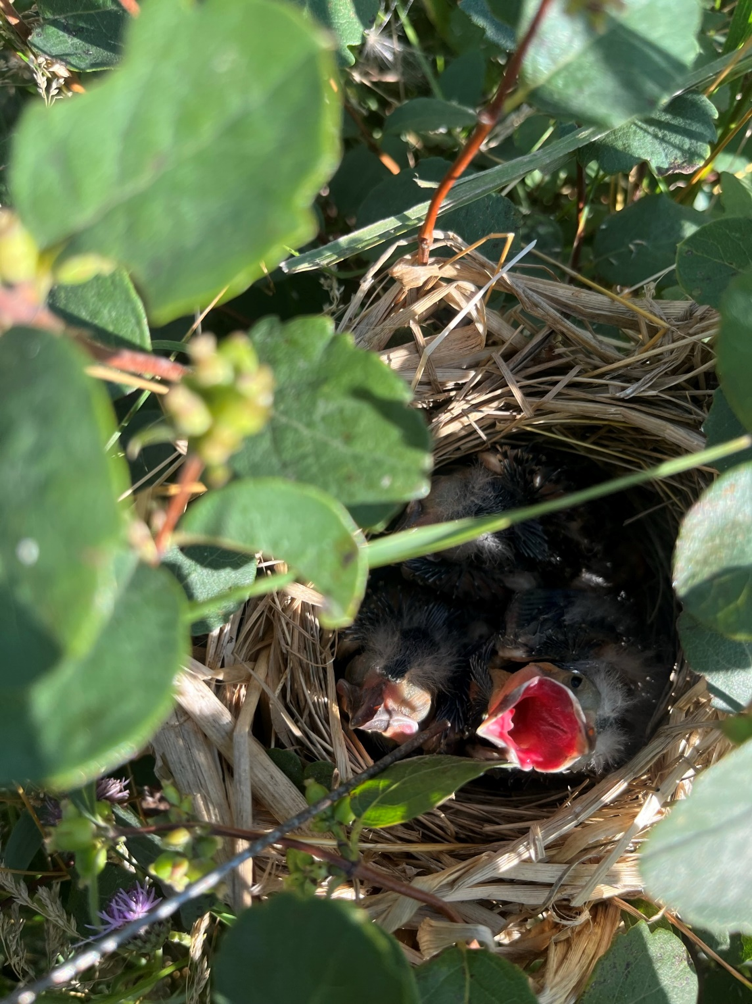
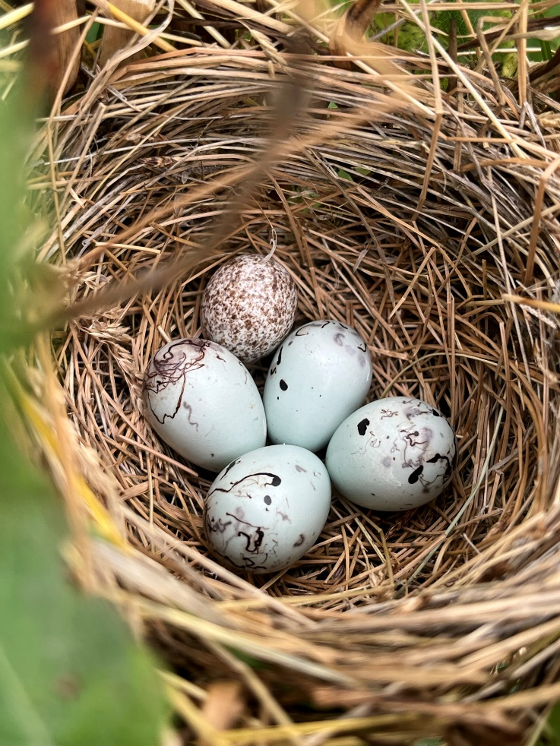
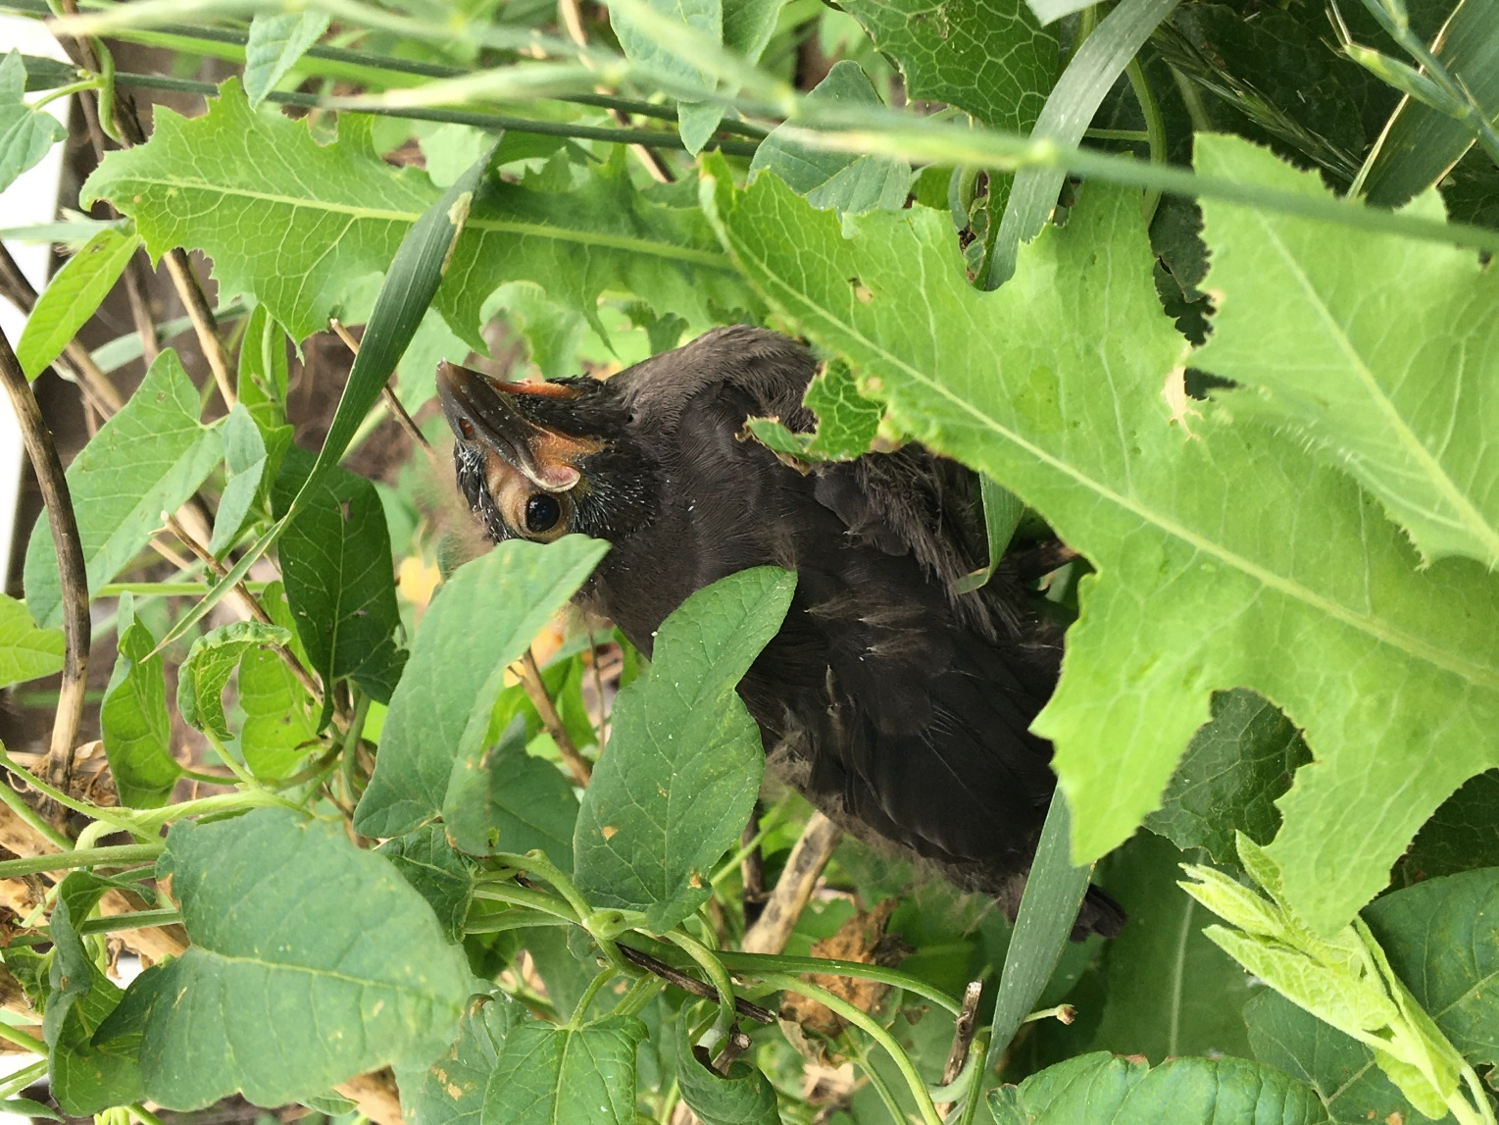
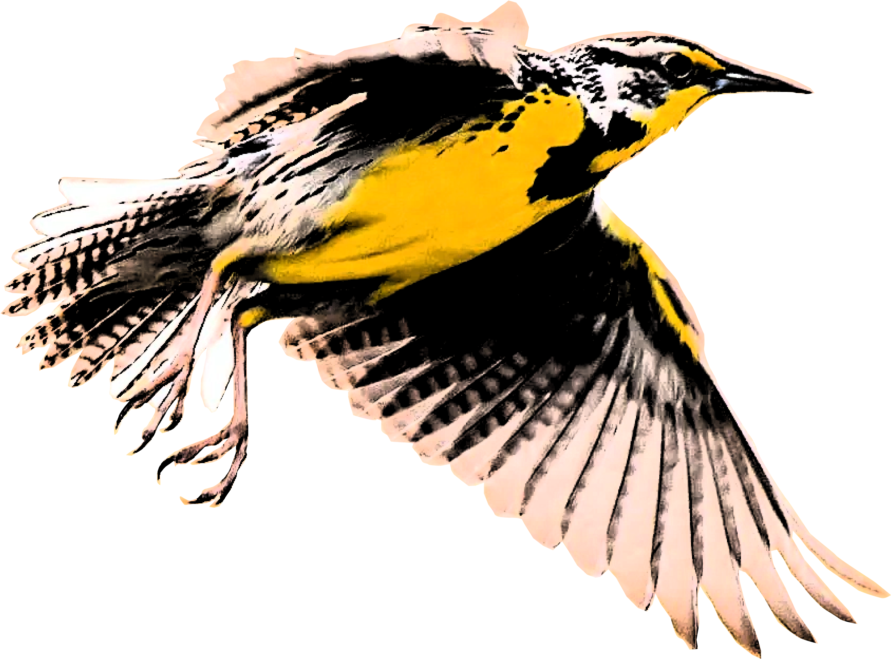
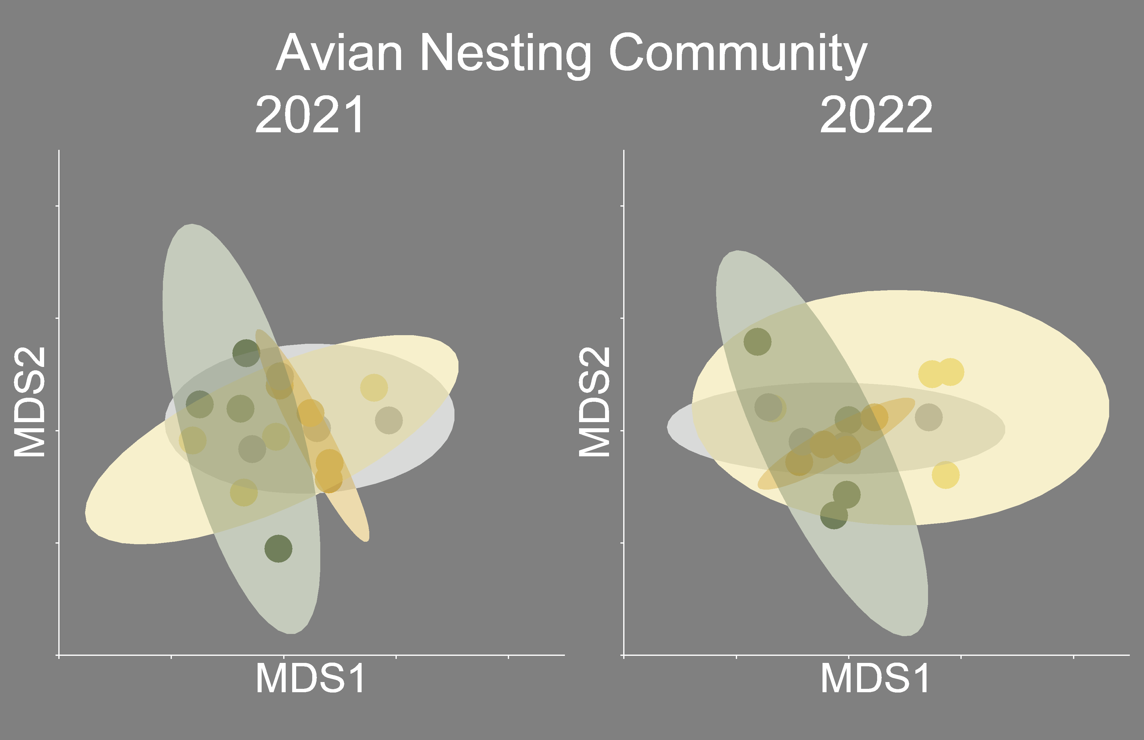


Avian Nesting Communities and Success in a Heterogeneity-based Rotational Grazing System
Justin Clarke¹, Torre Hovick¹, Kevin Sedivec^{1,2}, Ryan Limb³, Ben Geaumont⁴, Jason Harmon¹
¹ School of Natural Resource Sciences, North Dakota State University, ² Central Grasslands Research Extension Center, ³ Stantec, ⁴ Hettinger Research Extension Center
BACKGROUND
Grassland bird populations have declined significantly in the last 50 years, primarily due to habitat loss and degradation.
Current grazing management practices continue to degrade grassland bird habitat by homogenizing the landscape and lowering niche diversity resulting in less diverse avian communities.
Research has shown that increasing heterogeneity can benefit grassland bird diversity and increase nest success.
We propose a new method for restoring heterogeneity by modifying a common grazing practice in the northern Great Plains.
OBJECTIVES
Assess the impacts of different grazing intensity levels to:
Vegetation structure
Avian nesting richness, diversity, and composition
Avian nesting survival
METHODS
Modified Twice-over Rest-rotation Grazing System
Pastures are divided into four paddocks based on percent utilization.
Heavy (60+ % utilization)
Full (40-60% utilization)
Moderate ( 20-40% utilization)
Rest (0% utilization)
Paddock Scale Vegetation Sampling
We measured vegetation along three 25-m transects in each paddock.
We took visual obstruction readings (VOR) and litter depth measurements at 0, 12.5, and 25-m.
Nest Dragging and Monitoring
We conducted nest drags from late-May
to mid-July within each paddock.
We monitored nests every 2-4 days to
determine fate.
Successful nests fledged at least one host chick.
We considered nests lacking these indicators as failed.
Nest Vegetation Sampling
We measured nest vegetation within 2-3 days of the fledge date for successful nests or the expected fledge date for failed nests.
ABC
BC
BC
A
2021
A
A
A
A
A
A
B
B
2022
A
A
A
A
A
AB
B
A
Vegetation structural measurements are grouped into grazing intensities for each year. Significance is indicated by unique letters above each graph.
Species richness was significantly different between grazing intensities as indicated by unique letters (p = 0.008). However, Simpson’s diversity was significantly different between years (p = 0.02) but not between grazing intensities within a year.
IMPLICATIONS
Variation in grazing intensities impacts vegetation structure, but changes can be complex.
Vegetation height changes within a year.
Litter depth changes the following year.
Grazing intensity may impact species richness but does not alter community composition.
Nest success may be impacted by grazing intensity due to impacts on vegetation structure.
Responses were varied and species-specific.
Nest Survival Models
Species | DSR | KBG | Litter | Forb | Litter Depth | Veg Height
1. Western Meadowlark | 0.91 | (-) |  |  |  | -
2. Red-winged Blackbird | 0.95 | - |  |  | -
3. Brewer’s Blackbird | 0.95 | + |  | +
4. Clay-colored Sparrow | 0.89 |  |  |  |  | (+)
5. Blue-winged Teal | 0.97 |  |  |  | -
6. Gadwall | 0.98 |  |  | (+) |  | (+)
7. Northern Pintail | 0.92 |  | -
8. Mourning Dove | 0.96 | + |  |  | +
Heavy
Full
Moderate
Rest
The ordination compares avian nesting communities between grazing intensities where more distant points are more dissimilar. Ellipses show 95% confidence intervals. There was no significant difference in nesting communities between grazing intensities for 2021 or 2022 (PERMANOVA; p = 0.06, 0.10, respectively).
Contact Information
justin.r.clarke@ndsu.edu
Scan the QR code for references and additional information
Top nest survival models for the 8 most abundant species with daily survival rate (DSR). + indicates a positive effect, - indicates a negative effect, and () indicated confidence limits that overlap 0.

